Slide 1

There's a GameStop on the Moon Now Apparently

Slide 2
Introduction
In January of 2021, Citron Research announced on Twitter that it would be hosting an event laying out the short case again GameStop (GME).
Later that month, a major financial short squeeze occurred, centered predominantly around GME and other securities.
Notes:
Citron, ran by famed and active short sell Andrew Left
Citron claimed its models were currently predicting GME shares would go back to $20 (in mid-January it was trading actively at around $40 a share)

Slide 3
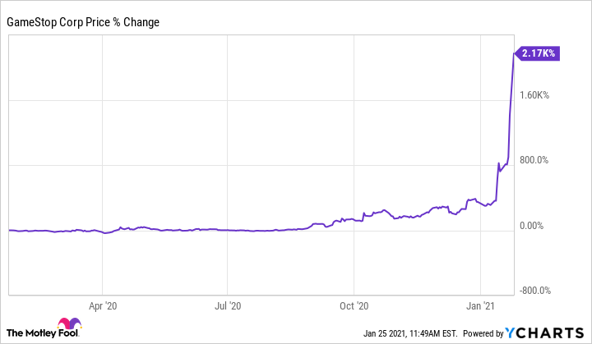
GameStop Change
At the height of the Squeeze, GME’s price per share had reached a pre-market value of over $500 per share.
Nearly 30 times the $17.25 valuation it had at the beginning of January.
Notes:
-Driven by do-it-yourself brokerage apps like Robinhood GME was the highest traded stock on the market.
- The change in GME’s price was over 2,000%

Slide 4
The Players
GameStop: An American high street shop that sells game, consoles, and other electronics.
Hedge Funds: A fancy name for an investment partnership that has freer rein to invest aggressively compared to mutual funds.
Retail investors: Non-professional investors who conduct their transactions through online platforms they control themselves.
Many of which frequented the r/WallStreetBets subreddit.
Notes:
In late 2020, Ryan Cohen, the former CEO of Chewy, built up a position in GameStop, managing to hold a 13% stake in the company effectively giving him three seats on the board of trustees.
Many of these hedge funds were shorting GameStop at 140%
r/WSB: An online community of retail investors who gather to share and trade investing advice.
In late 2020, Keith Gills invested his entire life saving into GameStop when it was priced at $20 a share. 50,000 shares
Cohen advocated the idea that GameStop had the potential to become the Amazon of the video game industry.
His vision lead many retail investors to rally behind GameStop, resulting in a surge in its stock value, bringing the timeline right into mid-January.
This promoted Citron to response and then retail investors to counter

Slide 5
What even is a stock?
A stock is an investment, when an individual purchases a company’s stock, they are purchasing a small piece of ownership in that company, called a share.
Stocks carry more risk than other investments, but they also have the potential to reap higher rewards, making them an attractive investment opportunity.
Notes:
Stocks can only be issued by companies that decided to go “public,” private companies do not sell shares in their company.
In the early 1600’s The Dutch East India Company was the first corporation to be listed on an official stock exchange.

Slide 6
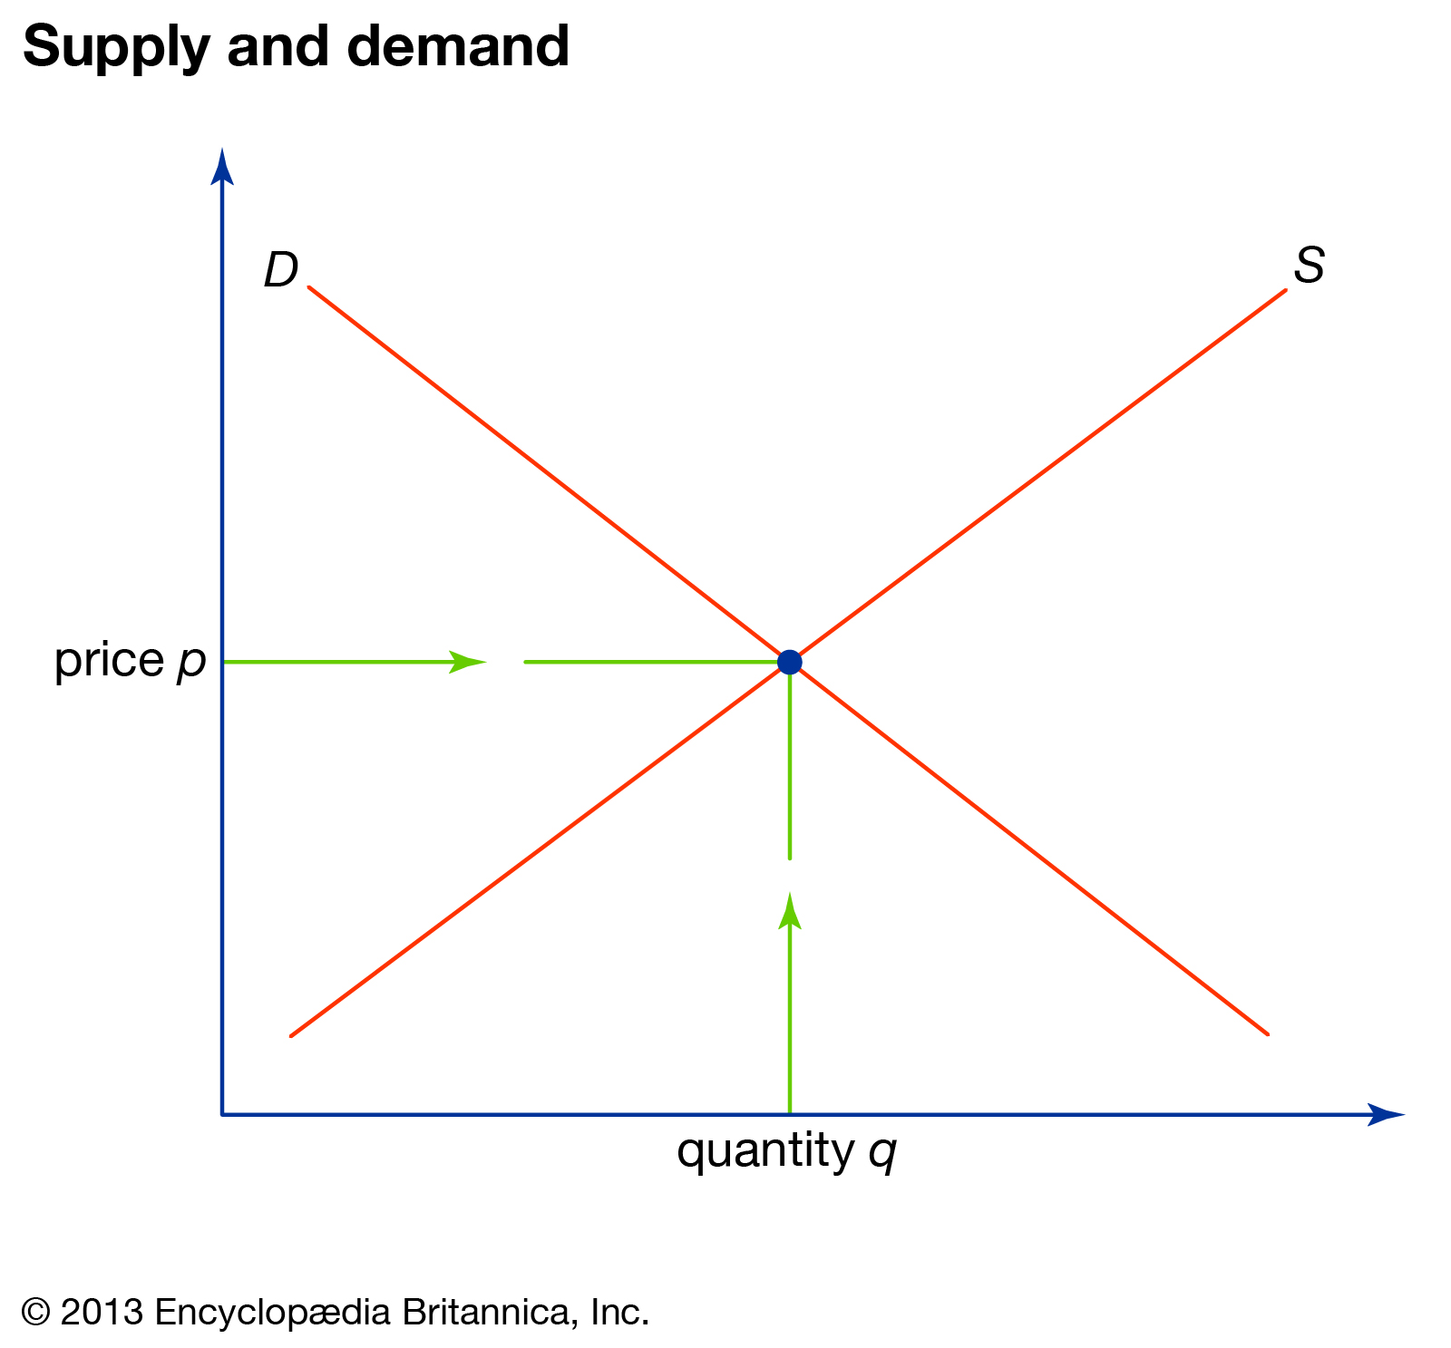
The Market
It’s believed that the stock market is “efficient,” since all market prices theoretically reflect all given knowledge available about the stock.
When do stocks increase or decrease in value then?
Notes:
- In Economics, it’s regarded that the market determines stock prices.
- Like all other known markets. Stocks are typically bought and sold on markets known as stock markets.
- In Economics, the law of supply and demand is a theory that seeks to explain the relationship between the availability and desire for a product, such as a security, and its price.
- Typically, low availability and high demand boost the price of an item and high availability and low demand reduce its price.
- The law affects the stock market by determining the prices of the individual stocks that make up the market.
This is commonly referred to as the Efficient Market Hypothesis.
What makes the stock market so unique is the fact that everybody play’s every role including, mutual fund managers, informed investors, uninformed investors, computers, etc.

Slide 7
The Dividend Discount Model
The dividend discount model (DDM) is a quantitative method used to predict the price of a company’s stock based on the theory that its stock’s present-day worth is the sum of all its future dividend payments, discounted back to their present value.

Slide 8
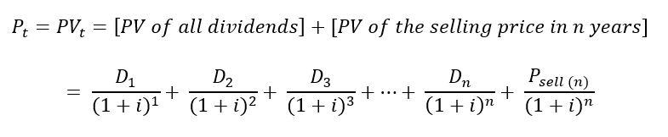
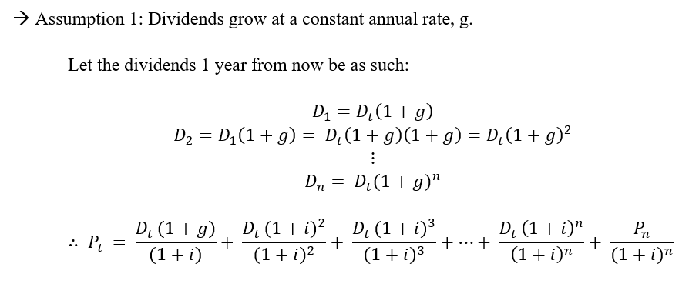
The Proof pt. 1

Slide 9
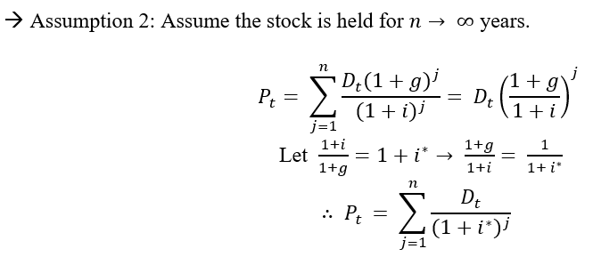
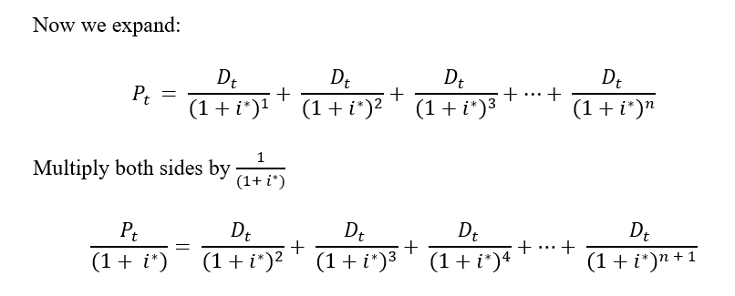
The Proof pt. 2

Slide 10
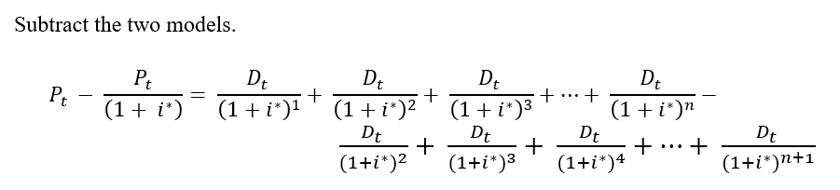
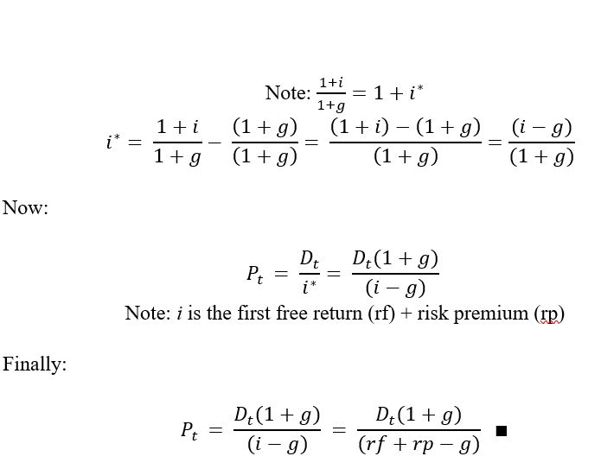
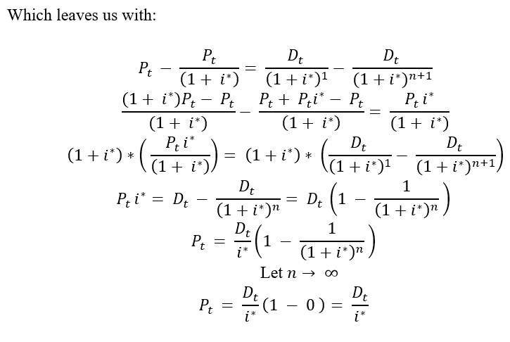
The Proof pt. 3

Slide 11
When does price increase?
When dividends increase.
When the growth of dividends increases.
When the risk-free return and / or the risk premium decrease.

Slide 12
What does this mean?
What’s unique about the GameStop Short Squeeze is that its increase in price cannot be tied to any components of the DDM.
The Efficient Market Hypothesis dictates that the price of GameStop’s stock value should be represented within these components as they reflect all known information about the company.
This was not the case; the GameStop short squeeze was not rooted in fundamentals.

Slide 13
Shorting
When an individual thinks a company that they like will do good, they buy stock in that company with the hopes it will increase in value so that they can sell for a profit. This is referred to as going long.
When an individual thinks a company will do poorly in the future, they can sell shares of it now with the intent to purchase those shares later. This is referred to as going short.
Hence shorting...
Notes:
For many of the billion-dollar hedge funds involved within the GameStop Short Squeeze, their involvement comes from the fact that their “bet” on GameStop was to short it.
When

Slide 14
An Example
Euler Incorporation (EI) is a struggling technology company, an investor, who feels that EI’s next invention is going to flop decides to short 100 shares of the company.
Through a miscellaneous brokerage service this investor decides to sell 100 shares at $10 per share (the market value), earning them $1,000.
This investor also must pay a small borrowing fee and put down a deposit worth 150% of the financial transaction, called a margin agreement.
It’s important to note that this investor does not own these 100 shares, in fact, they belong to someone else entirely.
Notes:
- Shorting is the right to sell shares you do not own

Slide 15
Example Continued
This investor now owes 100 shares of EI to some anonymous investor in n days.
After n days, the price of EI has fallen to $2 a share, their recent invention was a huge flop.
This investor then enters the market and buys 100 shares of EI for a total cost of $200 and returns those 100 shares to whomever they borrowed them from through their brokerage service.
This investor’s profits of their short position is now: $1000 - $200 = $800
Their return on investment is: 800 / 1000 *100 = 80%
Notes:
- Consider for this exercise that the fee to short was $0

Slide 16
Example Continued
Since stocks can never be priced at $0 a share, it’s impossible to achieve a 100% return on investment when shorting, despite the potential for a stock to increase or decrease over 100% in value.
Since shorting allows investors to sell stock they do not directly own, it makes it possible for a situation called naked shorting to occur.
Notes:
Naked shorting is the illegal practice of shorting shares that have not been affirmatively determined to exist.
When an investor wants to short, brokerage services must determine if the stock they want to short can be borrowed before they can sell it (the float).
At one point, prior to the squeeze, approximately 140% of GameStop shares were being shorted, allowing for the final condition for the short squeeze to occur.

Slide 17
What is a Short Squeeze
Let’s now say that, instead, after the n days are up, EI’s invention was actually a huge success, resulting in the value of their stock to skyrocket.
An investor who shorts, after whatever number of days, no matter what price, must pay back the shares they owe.
EI’s stock has shot up to $20 a share, a 100% increase in value, since there is no technical limit to how high a stock can increase in value, there’s no limit to how much an investor could lose when shorting.
Notes:
What’s worse is that that the act of buying shares in a company adds more demand for that stock, so for an investor who shorts EI, their act of buying more shares results in the price per share to increase as well
While the price per share of EI might be $20 when this investor goes to buy, by the end of it, when they have finished purchasing the 100 shares they own, the price of the stock could have increased in the meantime, costing the investor more money.

Slide 18
Short Squeeze Continued
If the price per share gets high enough, the individual whom this investor borrowed from might margin call them.
In this case, the value of the investors deposit was $1,500. If the price of EI goes above 50% of its original price ($10) – above $15 – then this investors original $1,500 deposit no longer cover’s their potential loses.
This would result in the investor having to put down more money, this is a margin call, this investor’s short position is now “squeezing” them out of money.

Slide 19
The Case with GameStop
Described is exactly what happened with GameStop, Hedge Funds such as Melvin and Citron, shorted GameStop.
By January 28th, Melvin Capital had already lost 30 percent of its value since the start of 2021, by the end of January a loss of 53% of its investments had occurred.
Notes:
- They borrowed, put down a deposit to cover potential losses through a margin requirement and sold shares.

Slide 20
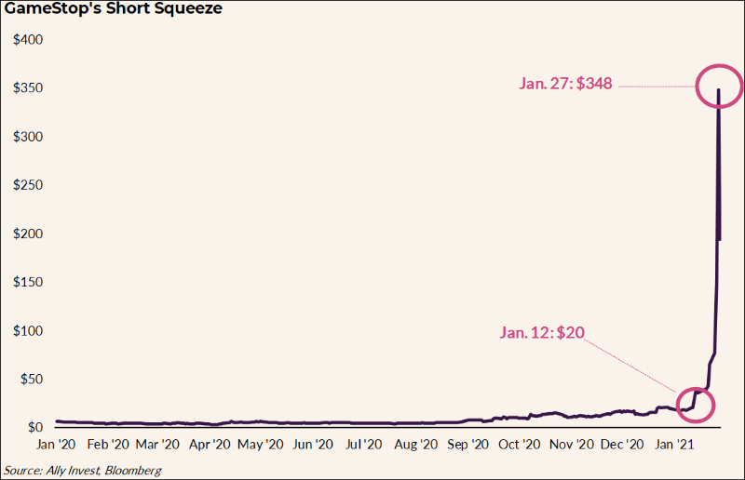
GameStop Squeeze
Current analysis of the situation calculated losses on short positions in U.S. firms to be greater than $70 billion.

Slide 21
Options
With nearly a $70 billion dollars in losses, where exactly did all this money go?
Options are financial derivatives that give buyers the right, but not the obligation, to buy or sell an underlying asset at an agreed-upon price and date.

Slide 22
Call Options
A Call Option is a contract between a seller (called the writer) and a buyer.
The buyer has the right, but not the obligation, to buy from the seller (call for) a stock at a fixed price called the exercise or strike price.
Generally, for options on stocks, Call Options give the holder the right to buy 100 shares of a company at the strike price up until or on the expiration date depending on the call.

Slide 23
Call Options Continued
The market price of a Call Option is called the premium, the price paid for the rights that the call option provides.
If it’s above, the profit is the current stock price minus the strike price and premium.
This is then multiplied by how many shares the option buyer controls.
Referred to as, “In the money.”
Notes:
- If at the time of expiration, the asset is below the strike price, the call buyer losses the premium paid, the maximum loss.

Slide 24
Example 2
Consider a single Call Option that may give a holder the right to buy 100 shares of EI at $10 up until the expiry date.
If EI is trading at $20 at the date of expiration, the strike price is $10, and the options cost the buyer $1, the profit is: $20-($10+$1) = $9
If the buyer bough one contract, that equates to $9 * 100 = $900, per contract.
If at the date of expiration, the price of EI is below $10, then the option buyer loses $1 * 100 = $100 for each contract bought.

Slide 25
Example 2 Continued
Call Options are generally used to generate income, speculation, and tax management.
Responsible short sellers use call options as a hedge (reduction in risk) against the trade falling apart on them.
An investor who shorts 100 shares of EI at $10 a share might also buy the option to purchase 100 shares of EI at $10 for $1 per contract.
If EI were to run to $20 (rather than decrease), the trader can exercise the option and pay the lender back with the stock received on exercise.

Slide 26
The Gamble
Hedges eat into profits, so shorts with conviction do not buy options to hedge, such was the case with GameStop.
Retail investors on r/WallStreetBets realized this gamble and jumped into the Options game in order to generate income on the potential squeeze by buying GME call options.
This gave them a stake in the squeeze and the upward momentum without having to buy GME stock out of the market.

Slide 27
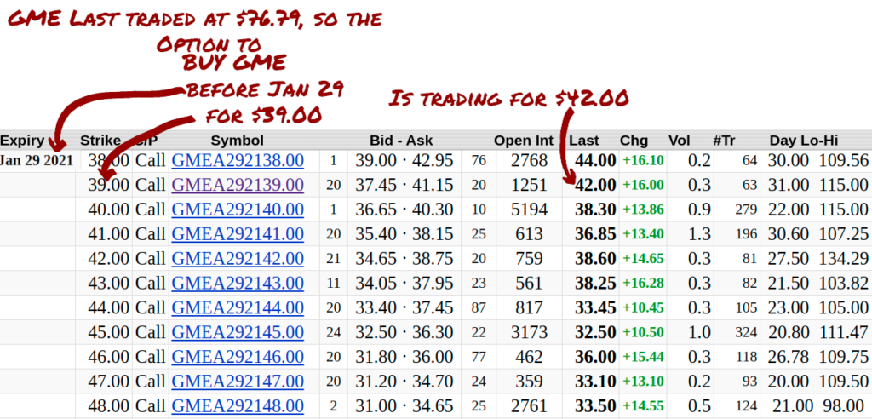
GameStop Options
Jan 29th, Expiry date.
A $39 Strike Price trading at $42.00 per contract.
Notes:
- A retail investor on r/WallStreetBets will gamble on GME continuing to go up and buy the call option in hopes that the shares of GME they purchased the right to buy will be worth more than the strike price of $39 before the contract’s expiration date. (In the money)

Slide 28
The Payout
The $39 GME Call Option, expiring on 29th, was trading for $42, a cost of $3 for the call options, so their profit is:
$76.79 – ($39 + $3) = $34.79
If they bought one contract that equates to $3479 ($34.79 * 100)
An individual who bought this option at $3 would then have seen a return on investment of:
(3479 / 300) * 100 = 1160%
Notes:
Proft – Cost / Cost

Slide 29
The Role of Mathematics
Moving forward it's important for established investors to not forget where much of modern finances draws its roots from, mathematics, so that next time, Hedge Funds with decades worth of financial experience do not find themselves out $70 billion, lost to some stranger behind a screen whose username is “Roaring Kitty.”
Notes:
- By early February, GME was floated at a price of around $50 a share.
- Keith Gill, who bet his life savings ($53,000) back on late 2020, who at the height of the short squeeze had assumed an investment worth close to $50 million (a 94339% return on investment), has no regrets about not liquidating all his assets.

Slide 30
Questions?

